Slide 1
School-Church Partnerships
Green Lake Local Outreach Ministry

Slide 2
Why School-Church Partnerships?
To be a good neighbor, showing the love of Christ
Build stronger communities and neighborhoods
Support education as a pathway toward bright futures and out of poverty
To build relationships with people of different backgrounds and be advocates for justice and equality

Slide 3



Partnership Statement
Our vision as neighbors, is to create a flourishing, safe, healthy community. Together we strive to support kids, families, teachers & staff of DBE, and our broader community through shared learning and connection of resources.

Slide 4
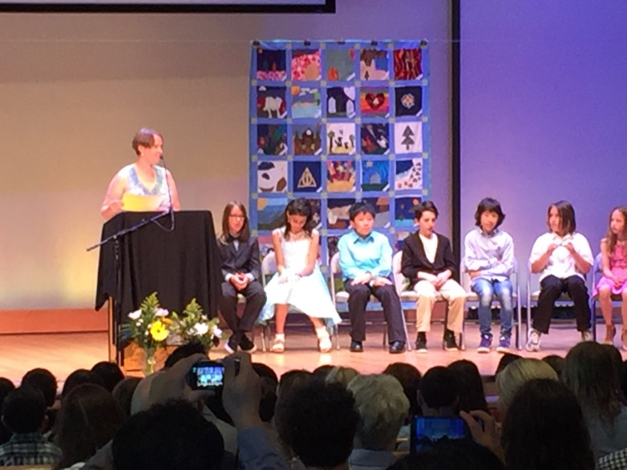
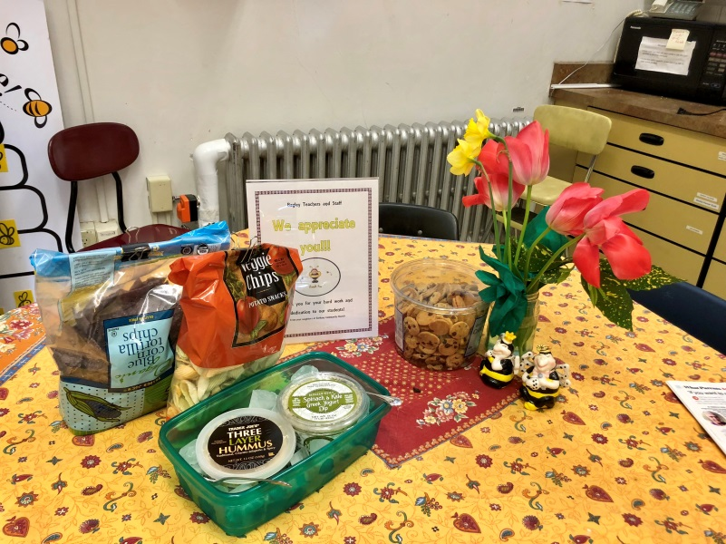
What we’ve done this year!
Hosted 5th Grade graduation in our Sanctuary
Hosted PTA events
Hosted at Bethany with UGM & Seattle Public Schools the School-Church Partnership Creation Event
Combined “Parent Ed Night” with DBE & BCC families
Share our CLC Food Bank space with the DBE PTA Food closet
Allow Bagley Staff & PTA to access our Food Bank to serve Bagley families as needed
Staff Appreciation in the teacher’s lounge
Supported Bagley Giving Circle & Backpack program

Slide 5
What we’ve done this year!
“You continue to SO rock! Thanks for being such EPIC neighbors!”
“Thanks for all that you do to support us, best-neighbors-ever!”
-- Bagley Teachers
‘You shall love your neighbor as yourself.’ --- Jesus (Matthew 22:39)

Slide 6
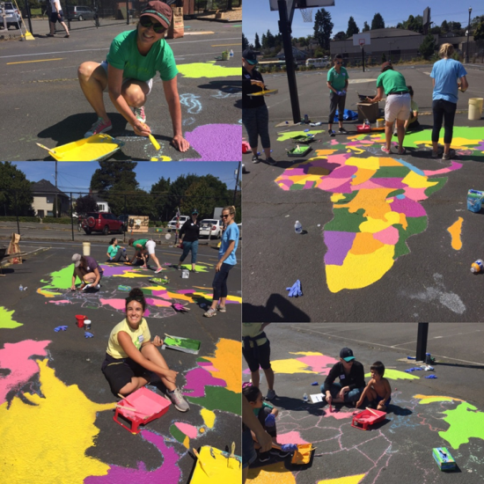
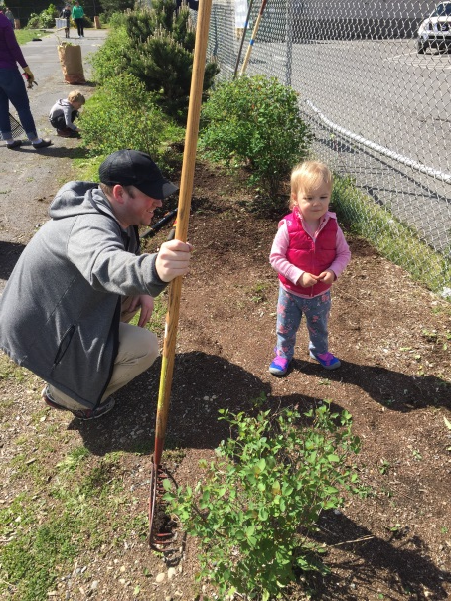
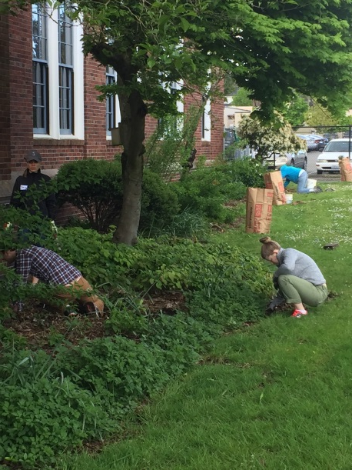
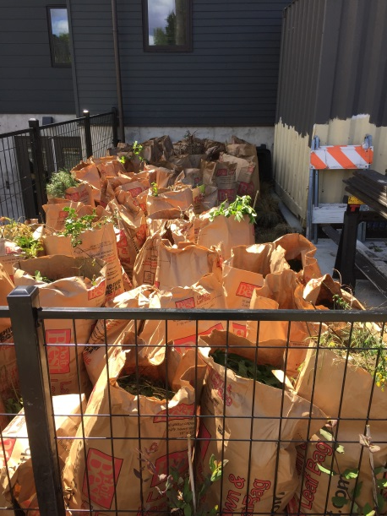
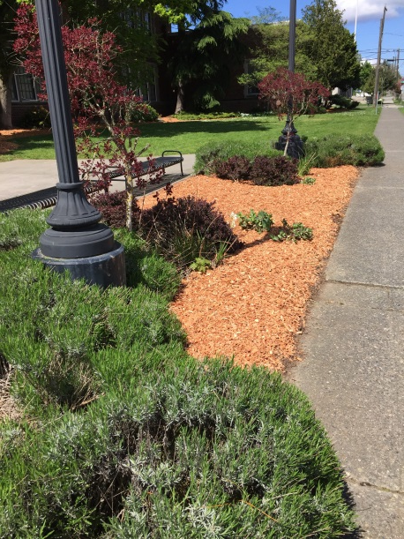
What we’ve done this year!
Serve Day 2017
  Grounds work
  New world map for the playground

Slide 7
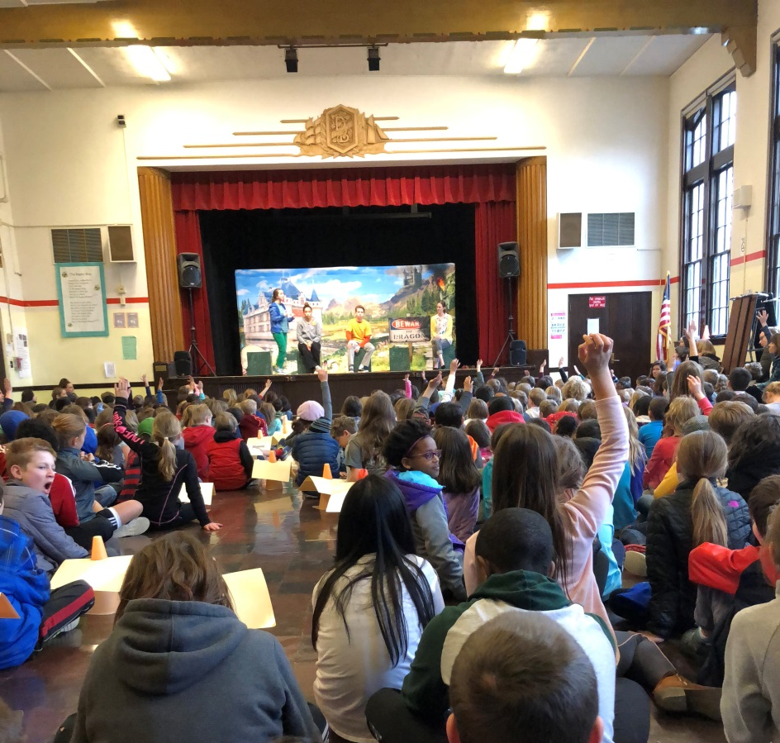
What we’ve done this year!
Provided an all school “Bullying Prevention” assembly for both MLK & DBE put on by Taproot Theatre
“Can we do it again next year? Our students really responded”
-Carla Holmes, Principal DBE

Slide 8
Upcoming Opportunities to Serve
Serve Day 2018! – Saturday, August 18 9am-Noon
  Sign up on-line churchbcc.org
New Mentoring program Fall 2018 for DBE
  Partnering with Youth Wise – See Greg Engle in the foyer!
Join the Bagley School-Church ministry team
  Contact Pastor Phil philm@churchbcc.org
  Get your small group involved!

Slide 9
Martin Luther King, Jr Elementary & Holly Park Community Church
BCC will partner with Pastor Otis and the people of HPCC as we follow their lead in a School-Church Partnership with MLK, Jr Elementary. HPCC is uniquely positioned in the Rainier Valley to leverage it’s facilities and community involvement to partner one of the most underserved schools in the district.

Slide 10
The Future
We hope to be more involved relationally as we serve more and more inside the school. Mentorship is one step. Supporting classrooms/teachers more directly is another.
We will be inviting Bagley families to join us for family, marriage, and parenting events at Bethany.

